Slide 1
<ALARM MANAGER >
Project Team Members:
<Pruthvi patil> <1AY18IS084>
<Malipeddu harshavardhan> <1AY18IS063>
1

Slide 2
Agenda
2
Abstract
Introduction
Problem Statement
Design(Data Flow Diagram)
Requirement Specification

Slide 3
ABSTRACT
The main aim of this project is to develop a android application which helps the user in his time maintenance..
With the help of this application The user can view Indian standard time as well as he can put alarm at any particular time .

Slide 4
INTRODUCTION
Android AlarmManager allows you to access system alarm.
The Android AlarmManager holds a CPU wake lock that provides guarantee not to sleep the phone until broadcast is handled.
The user can put any of his favourite songs as a alarm ringtone.
An alarm clock is a clock that is designed to alert an individual or group of individuals at a specified time. The primary function of these clocks is to awaken .

Slide 5
PROBLEM STATEMENT
The alarm manager application developed here mainly to help users in time management
Its even useful for users health as It normalizes the user’s sleep schedule by waking him up early.
The user might miss big occasions of his life just because of his time negligence
but alarm manager make sures that the user should not miss any of his occasions by
time remiders.

Slide 6
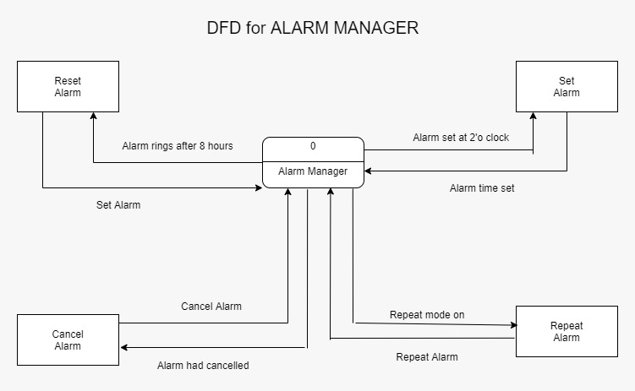
DATA FLOW DIAGRAM

Slide 7
REQUIREMENT SPECIFICATION
Only one smart device is required for operation, and the device specifications must meet the minimum operating requirements of the software. In the running software, the software will always run in the background, through the user settings and monitoring of all user activities and through analysis to give users a more convenient use environment.
The device must have android version of 5.0 or above to run the application.
The device minimum RAM should be 1gb for smooth working of this application.

Slide 8
8

